Slide 1
STL Decomposition
Renato R. Maaliw III, DIT
College of Engineering
Southern Luzon State University
Lucban, Quezon, Philippines

Slide 2
STL
Seasonal-Trend Decomposition using LOESS
Uses locally weighted regression for smoothing
Allows flexible seasonality adjustments

Slide 3
STL
Better than traditional methods (like ETS)
It can handle changing seasonality
Robust to outliers

Slide 4
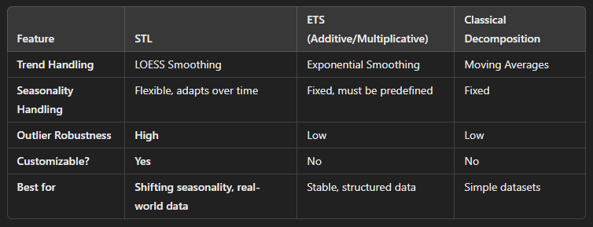

Slide 5
Key Benefits of STL
Handles complex seasonality (climate, traffic)
Works with irregular time series (non-uniform observations
More accurate that traditional methods
Robust to outliers

Slide 6
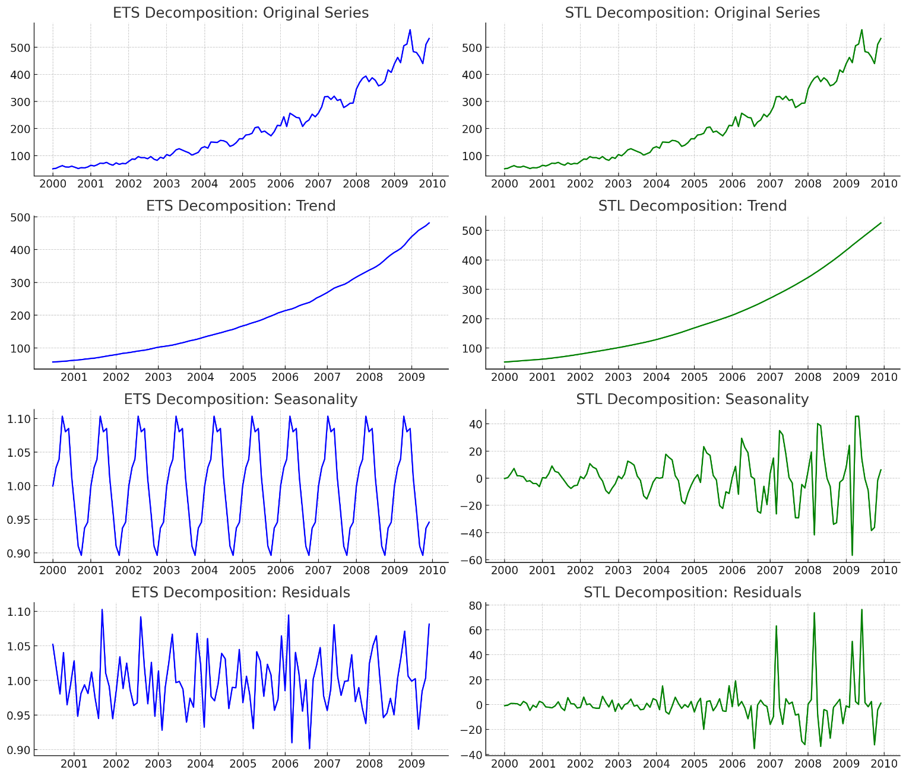
Trend
ETS:
Rigid and smooth
Works well when trend is steady
STL
Flexible, captures variations better
Can detect local trend shifts that ETS might smooth out too aggressively
* If you need smooth forecast, ETS is better. If your trend changes over time, STL is better *

Slide 7
Seasonality
ETS:
Seasonality is fixed, it assumes same seasonal pattern throughout.
If seasonality changes over time, ETS might not capture it well.
STL
Seasonality is more flexible & adjusts slightly over time.
Allows for shifting seasonal effects, making it better for handling seasonality changes
* If seasonality remains constant, ETS is good. If seasonality shifts over time, STL is better *

Slide 8
Residual
ETS:
More structured, it might not fully capture some variations.
This could lead to autocorrelated residuals, which is not ideal.
STL
The residuals look more random, meaning it has done a better job of extracting trend and seasonality, making it robust to outliers.
* If your data has sudden changes or outliers, STL is better. If your data is stable, ETS is fine.

Slide 9
[Code Demo]

Slide 10
Thank you very much for listening.

